Slide 1


Credit Cards - Fraud Detection
Data Architecture
Sashidhar Bezawada

Slide 2
Agenda
Introduction
Data Architecture - Proposed
Data Flow and Real-time Analysis
Data Storage, Retrieval, and Analysis
Cost Estimate
Conclusion

Slide 3


Introduction
Money laundering - An issue haunting banks and financial institutions for decades.
Needs constant monitoring with utmost scrutiny, even a slight error or mismanagement can put the bank in a legal nightmare.
Compliance requirements are dynamic and updated quite frequently. It makes it even more tricky for the bank to keep up with them. Technology brings agility, accuracy, efficiency, and more importantly better prevention against financial crimes.
To address the rising threat of credit card fraud and the stringent regulatory requirements for anti-money laundering measures, the next slide has the Data architecture that can support the Fraud Detection Models.
The Data Pipeline can be divided into six stages: Collection, Ingestion, Streaming, Storage, Machine Learning Model and Visualization

Slide 4
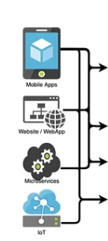





Data Architecture ( Proposed )
Batch processing
Realtime processing
Data Collection
Data Ingestion
/ Validations
Data Streaming
Data Lake
Storage : Hadoop & Hive
Data Search :
SOL
Machine Learning Model
Data Visualization
Tableau

Slide 5
Data Flow and Real-time Analysis
Data Collection :
For fraud detection and prevention, we need
Historical data in the bank databases which record all normal transactions, as well as all known frauds.
Live data that need to be collected from various sources in real-time.
The amount of data collected for this kind of project will be enormous, it could be Point of Sale credit card transactions data, online payments data, mobile apps, customer profile data and many more.
Data Ingestion :
NiFi facilitates the ingestion of real-time data by providing scalable, flexible, and reliable data ingestion, processing, and routing capabilities.
Its intuitive GUI, extensive connectivity options, real-time processing capabilities, and built-in security features make it a powerful tool for managing data flows.
Data Streaming :
Kafka plays a central role in the solution for managing high volume of data by providing a scalable, fault-tolerant, and real-time data streaming platform.

Slide 6
Data Storage, Retrieval and Advanced Analysis
Data Storage ( Data Lake) :
All of the data being stored in a centralized data repository that leverage inexpensive object storage and open format to enable various applications to use the data, this repository is often called as “data lake”.
HDFS offers significant advantages for storing vast amounts of historical data collected & live data, including scalability, fault tolerance, high throughput, data compression, cost-effectiveness, data locality, and seamless integration with the broader big data ecosystem.
Data Search :
Hive’s SQL-like query language, schema-on-read approach, metadata management capabilities, support for external tables, partitioning and bucketing features
Solr plays a critical role in indexing and enabling fast search on customer profiles and historical data related to the Fraud transactions.
Machine Learning Model Deployment:
Spark ML can be used for computation and machine learning modeling. For fraud detection, combination of batch and stream processing is needed. However before that, machine learning models need to be built, trained, and tested first. Exploratory Data Analysis (EDA) to analyze and visualize datasets, and formulate hypotheses also occurs in this stage. Well-maintained data lake becomes very important in this stage because models and insights are all stored back in the data lake.
Data Visualization :
Fraud prevention - warning notifications can be sent through customers’ email or SMSs if there is an unusual transaction occurring in their account.
Real-time dashboard – Tableau can be used as a reporting tool.

Slide 7
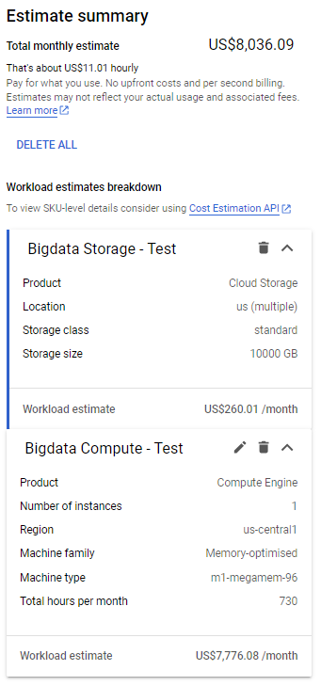
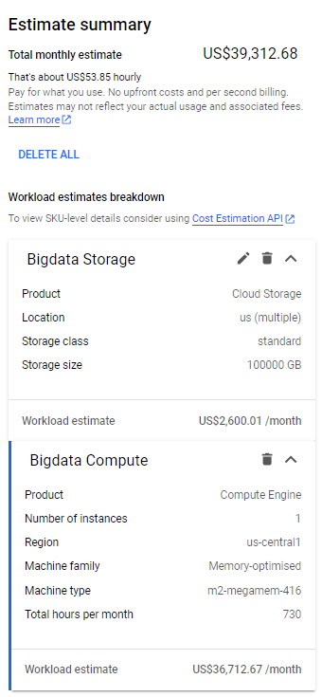
Cost Estimate
Test Environment :
Compute Engine Cost per Month : $ 7,800
Storage Cost per Month : $ 260
Total Infrastructure Cost per Year (approx) : $ 0.1 Million
Prod Environment :
Compute Engine Cost per Month : $ 37,000
Storage Cost per Month : $ 2,600
Total Infrastructure Cost per Year (approx) : $ 0.5 Million

Slide 8
Conclusion
Banks that lack dynamic and flexible fraud prevention technology platforms are at a severe competitive disadvantage, ultimately running the risk of slowing revenue growth, customer defections & reputational risk.
The proposed Architecture is Highly Scalable yet Cost effective.
Real time insights – Hadoop can be used to generate insights at a latency of a few milliseconds that can assist Banks in detecting fraud as soon as it happens

Slide 9

THANK YOU

